Slide 1
Trends and developments in grain trading
Matthé Vermeulen
27 november 2013

Slide 2
Who is Matthé Vermeulen?
President Royal Dutch Grain and
Feed Trade Association - Het Comité-
Trader in natural fertilizers
Board member GMP+
Board member Product Board Feed

Slide 3
Where do I take you?
The association Het Comité
Food and feed safety
Traffic Amsterdam and Rotterdam ports
International development cereals
  The Netherlands and Hungary
International development soya
What will cereal prices do?

Slide 4
Het Comité
HET COMITÉ IS FOUNDED IN 1872
Why?
Companies and People involved in Grain Trade and those related to the Grain Trade were looking for more mutual trade agreements concerning quantity and quality and desired more uniformity

Slide 5
HET COMITÉ TODAY
Today the activities of Het Comité are:
Safe Guarding and Promoting the members’ interests in the broadest sense
Stimulating Free trade and distribution of grain, oilseeds and raw materials for animal feed
Supplying information and providing services

Slide 6
STRUCTURE OF HET COMITÉ
Board
“Het Comité” - 8 members
Secretary - 4 employees
Trade Commission
Quality Commission
Contracts and Arbitration Commission
Commission
Human Consumption and Trade
CNGD
DNV
GAFTA
GZP
Logistics Commission

Slide 7
Important Topics Het Comité
Food safety
More uniform worldwide quality systems
Sustainability
Agricultural reform EU
Biotechnology / GMO’s
Crisis management (if necessary)

Slide 8
Food and Feed Safety
GMP/HACCP/Hygiene Code/ GTP
GMP+ code
quality requirements to ensure the traceability up to the country of origin
The international Code of Good Trading Practice with COCERAL (GTP)
Hygienic Code
quality requirements for the national collection and trade

Slide 9
GMP+
Product Board Animal Feed (PDV)
initiator of GMP
Het Comité is member involved in the drafting of the GMP and initiator of the conditions for publications of prior links (string)

Slide 10
GMP+
GMP+ International’s mission:
Responsibility / sustainability aspects are getting integrated in the interest of the current participants
active co-ordination and promotion of a uniform and standardized application of basic principles for the assurance of feed safety in the whole feed chain worldwide, in order to contribute to the production of safe food
10
Notes:
10

Slide 11
GMP+
Input for improvements:
Key elements of regulatory systems (EU, USA, China)
New scientific insights
Practical experiences (including incidents)
Needs in the market
GMP+ International’s mission:
Responsibility / sustainability aspects are getting integrated in the interest of the current participants
active co-ordination and promotion of a uniform and standardized application of basic principles for the assurance of feed safety in the whole feed chain worldwide, in order to contribute to the production of safe food
11
Notes:
11

Slide 12
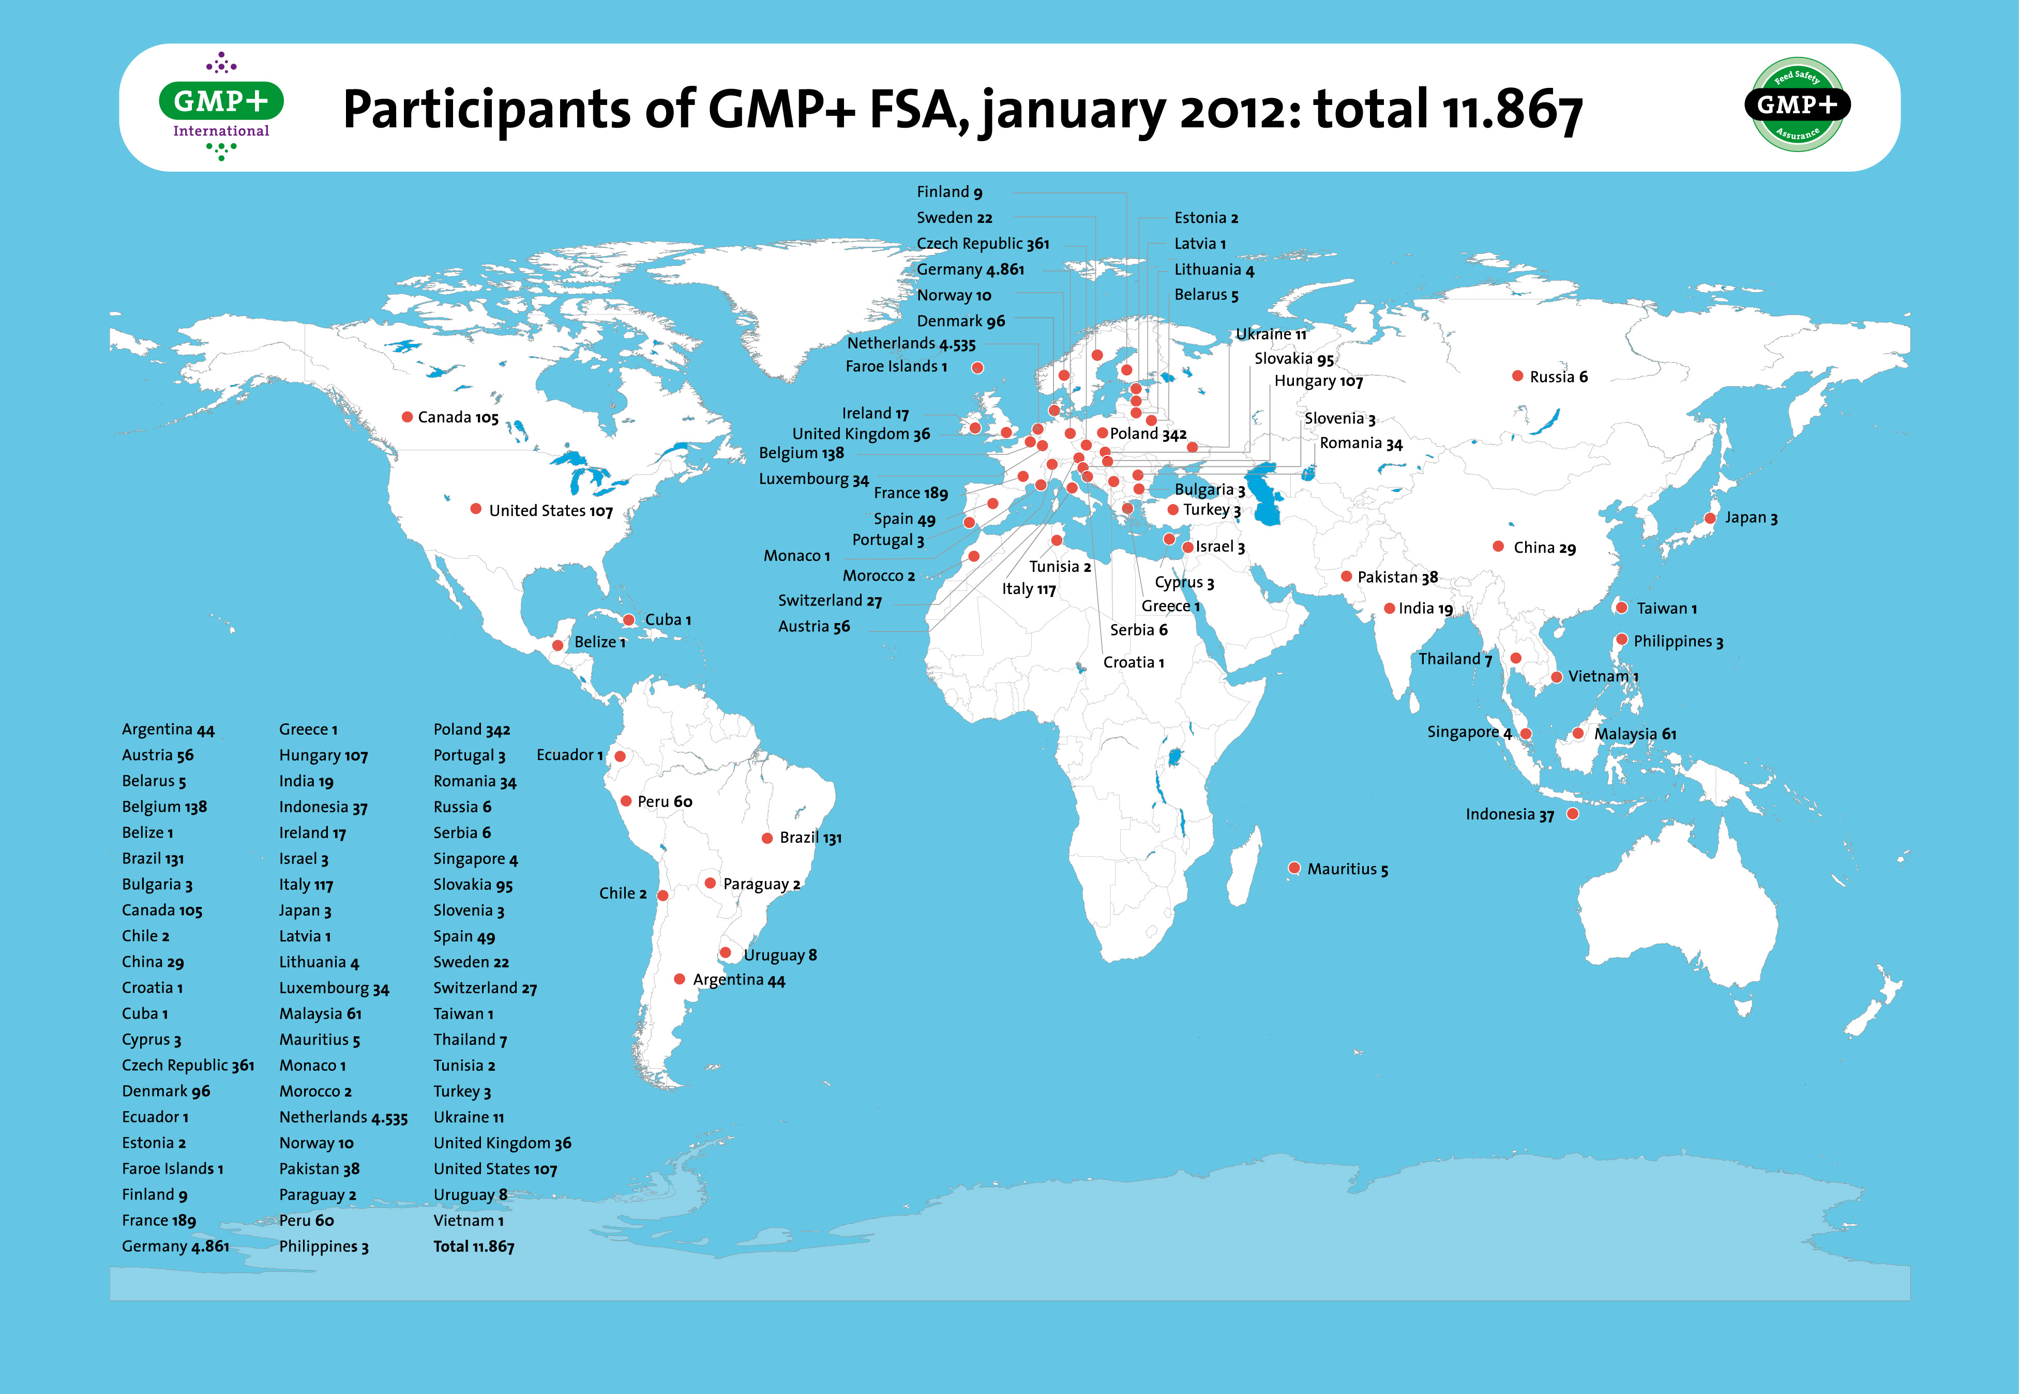
Currently : 01-11-2013
Worldwide : > 12.000
Hungary : > 105

Slide 13
GTP code
COCERAL is initiator of the GTP Code
COCERAL is the representative of cereals and feed stuffs trade in the EU
Het Comité is a member of the Board, involved in drafting GTP
GTP and GMP are mutually recognised
General requirements GTP
  Monitoring and control procedures, sampling and testing hygiene and safety standards, certification and verification
Specific requirements GTP
  Transport, elevation and storage, traceability food and feed, labelling, contaminants

Slide 14
Reasons to choose for a quality certification
Export feed products: Improves position on international market
Domestic market: Add value to animal products produced and marketed in local market (safer food)
Export of animal products: Add value to animal products exported to other countries
Economic benefits: improves efficiency and uniformity of internal and B2B operations
14

Slide 15
Import/export Amsterdam/Rotterdam

Slide 16
Agribulk: Market Shares HRH range 2007-2012
16
Notes:
16

Slide 17
Agribulk: Countries of Origins import into Amsterdam/Rotterdam
17
Notes:
17
Where is the agribulk coming from?
Argentina and Brazil, by far the biggest suppliers (mainly soymeal and soybeans)

Slide 18
Agribulk: destinations
UK, Baltic, Middle East: 10 %
domestic use: 55%
Germany:
25%
Rest 5 %
Austria:
5 %
18
Notes:
18
This chart clearly illustrates that the majority of the agribulk cargoes is for domestic use or transported by barge to destinations in the hinterland
Examples:
ADM crusher Rotterdam (ca 2.3 mln tons)
Bunge crusher in Mannheim
Cefetra imports for compound feed industry in NL
Toepfer, Glencore agri traders

Slide 19
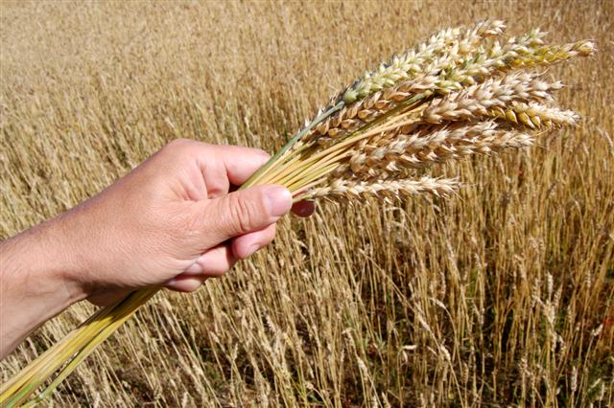
International developments cereals
19

Slide 20
International developments
Developments China and India are of utmost importance
Systems of minimum prices
  In China en India between $ 255,00 and $ 300,00 per ton
Systems of import levies for agricultural products almost throughout the world
  i.e. India is considering an export subsidy for sugar.
Worldwide increasing economic growth
  Increasing wages and land prices
  Yearly increase production cost cereals 6 – 8 %
Increase world population
  120.000 people per day
  To 9 billion people in 2050
  Economic growth India, China en Africa => increase meat consumption => grain for feed
20

Slide 21
World cereal production and consumption 2004 – 2013 (million tons)
21
Notes:
21
Uiteraard wordt er nog gesproken over een nieuw GLB maar ook over de handhaving van de quotasystemen voor melk en suiker,
Officiële presentatie van de Commissie medio november 2010 maar de plannen zijn al uitgelekt met als opmerkelijk gegeven dat men het weer heeft over voedselzekerheid en pas daarna over voedselveiligheid en milieu (maatschappelijke diensten, onderhoud landschap, dierenwelzijn)
Flat rate per land of regio met de een mogelijkheid tot een extra steun voor maatschappelijke diensten of ter verbetering van de biodiversiteit,
Zoals altijd gaat het over geld waarbij Nederland iets wil doen aan de nettobetalingpositie => men vergeet dat Nederland 70% van alle producten exporteert.
China, India en de landen in het Midden-Oosten hebben het oude EU landbouwbeleid gekopieerd

Slide 22
Forecast world cereal production and consumption until 2022 (OECD/FAO)
(Million tons)
22

Slide 23
EU Cereals consumption (275 Million t/yr)
Human consumption 24,1%
Seed 3,5%
Industry 7,7%
Ethanol 3,6%
Feed 60,2%
23

Slide 24
World and EU stocks of cereals in weeks of consumption
24

Slide 25
Where are the stocks of cereals?
25
Theoretical stock of cereals in the world
on 30 June 2013 was 334,6 million tons of which:
  116,2 million tons in China 34,7%
  43,0 million tons in the USA 12,9%
  25,8 million tons in India 7,7%
  21,9 million tons in the EU 6,5%
  11,6 million tons in Russia/Ukraine 3,5%
Biggest cereals importers are:
  Japan 24,1 million tons/yr➔ steady
  China 18,4 million tons/yr ➔ 2009: 4,8 million tons!
  South Korea 13,4 million tons/yr➔ steady
  EU 12,7 million tons/yr➔ will decrease
  Saudi Arabia 12,3 million tons/yr➔ increasing

Slide 26
Developments in the Netherlands
Steady cereal production between 1,6 up to 1,9 million ton
Highest production per HA.
  8,8 ton per hectare
  Average EU 5,3 ton per hectare
Yearly import of 8 to 9 million ton
  Origins: France, Germany, UK
Cereals are important for crop rotation
  Higher prices ➔ Increasing economic importance for farmer
26
Notes:
26
Uiteraard wordt er nog gesproken over een nieuw GLB maar ook over de handhaving van de quotasystemen voor melk en suiker,
Officiële presentatie van de Commissie medio november 2010 maar de plannen zijn al uitgelekt met als opmerkelijk gegeven dat men het weer heeft over voedselzekerheid en pas daarna over voedselveiligheid en milieu (maatschappelijke diensten, onderhoud landschap, dierenwelzijn)
Flat rate per land of regio met de een mogelijkheid tot een extra steun voor maatschappelijke diensten of ter verbetering van de biodiversiteit,
Zoals altijd gaat het over geld waarbij Nederland iets wil doen aan de nettobetalingpositie => men vergeet dat Nederland 70% van alle producten exporteert.
China, India en de landen in het Midden-Oosten hebben het oude EU landbouwbeleid gekopieerd

Slide 27
Hungarian Corn
Production 6,5 mio ton
Available for export 2,7 mio ton
Destinations:
  South of Germany 0,6 mio ton
  North Italy 1,0 mio ton
  Austria
  Netherlands/Belgium alternative Ukraine

Slide 28
Hungarian Wheat
Production 5 mio ton
Total export around 1,7 to 1,8 mio tons
Exports to
  Italy 584.000 Mt
  The Netherlands 276.000 Mt.
  Austria 206.000 Mt
  Germany 148.000 Mt
  Slovenia 140.000 Mt
  Rumania 123.000 Mt
  Poland 81.000 Mt.
  Greece 63.000 Mt
  Slowakia 22.000 Mt.
  Small quantities to Spain, France, Cyprus, ..

Slide 29
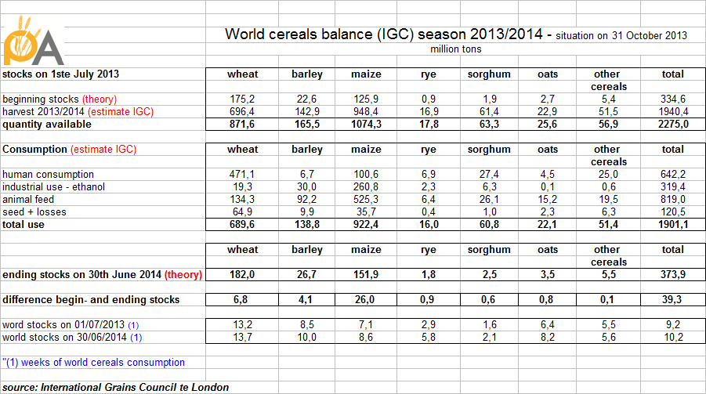
World Cereals Balance (IGC)

Slide 30
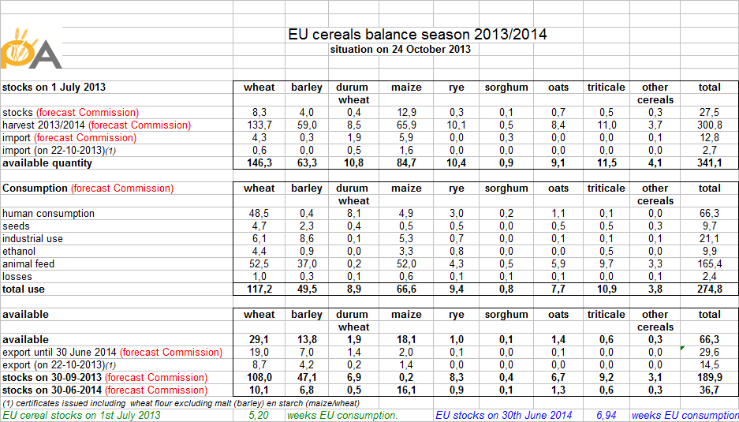
EU Cereals Balance

Slide 31
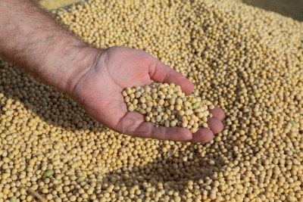
International developments Soya
31

Slide 32
World production and consumption Soya
2010 – 2014 (Million tons)
32
Notes:
32
Uiteraard wordt er nog gesproken over een nieuw GLB maar ook over de handhaving van de quotasystemen voor melk en suiker,
Officiële presentatie van de Commissie medio november 2010 maar de plannen zijn al uitgelekt met als opmerkelijk gegeven dat men het weer heeft over voedselzekerheid en pas daarna over voedselveiligheid en milieu (maatschappelijke diensten, onderhoud landschap, dierenwelzijn)
Flat rate per land of regio met de een mogelijkheid tot een extra steun voor maatschappelijke diensten of ter verbetering van de biodiversiteit,
Zoals altijd gaat het over geld waarbij Nederland iets wil doen aan de nettobetalingpositie => men vergeet dat Nederland 70% van alle producten exporteert.
China, India en de landen in het Midden-Oosten hebben het oude EU landbouwbeleid gekopieerd

Slide 33
Where are the stocks of Soya beans?
33
Theoretical world soya beans stocks were on 30 June 2013
26,3 million tons of which:
10,6 million tons in China 40,3%
3,8 million tons in the USA 14,4%
3,4 million tons in Argentina 12,9%
2,3 million tons on Brazil 8,7%
Biggest soya beans importers are:
China 68 million tons ➔ increasing
EU 12,1 million tons ➔ steady

Slide 34
The Brazilian logistic challenge
Modernize and increase capacity rail and water ways
Increase capacity port infrastructure
Complete overhaul of transport monopolies
Reduce bureaucracy and more transparent legal framework
Reduction union control over port facilities
Integration transport modalities

Slide 35
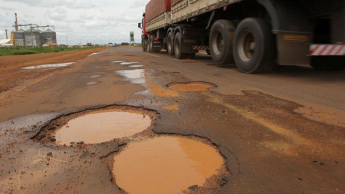
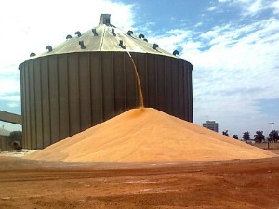
The Brazilian Cost
=

Slide 36
Transport modalities for Export

Slide 37
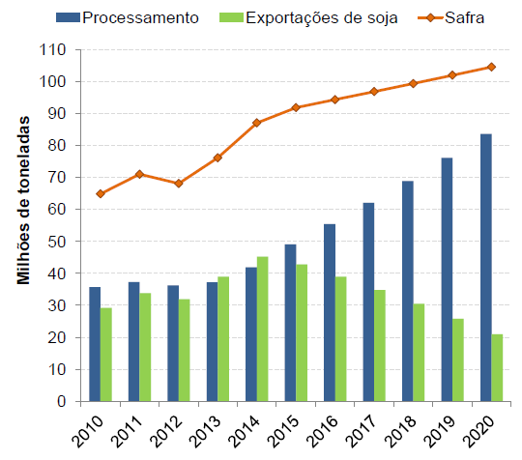
The crushing future
By 2020 Brazil expects to process/crush 80% of its total production.

Slide 38
Imports proteins (a.o soya) into the EU
Steady import of 12 million tons soya beans
  Permitted GMO events
  Pipeline of not permitted GMO events
Relatively limited production of:
  Rape seed 20,5 million tons
  Sunflower seed 8,1 million tons
  Soya 1,0 million tons
  Minor quantities of linseed, peas, beans and lupines
Possibilities in the long term of increasing acreage in the EU
  Testing all over EU
  OPPORTUNITIES!
38

Slide 39
What will cereal prices do?
39
Increase World population up to 9 billion in 2050
Economic growth ➔ increase meat consumption ➔ more cereals and soya for feed ( 1 kilo meat = 3 to 5 kilo cereals)
Oil price?
  If price > $ 140,00/ barrel ➔ commercial production ethanol possible
Yearly increase production cereals and soya with 2%
Cost of production in the world is increasing year over year
Permission GMO crops in EU➔ increasing production?
Decisive factor: MOTHER NATURE!

Slide 40
Thanks for your attention!
With thanks to FAO, University Wageningen, Arable Product Board
HET COMITÉ - T ++31 10 - 467 31 88 - E cvg@graan.com

